Slide 1
Current Helicity and Twist of Solar Magnetic Fields from Hinode/SOT SP and Ground Based Telescopes Data
K. Otsuji, T. Sakurai
National Astronomical Observatory of Japan
K. Kuzanyan
IZMIRAN, Russian Academy of Sciences, Russia

Slide 2
Abstract
Statistical studies on the current helicity and magnetic twists of magnetic fields in solar active regions
“The hemispheric sign rule”
current helicity is mainly negative/positive in the northern/southern hemispheres of the Sun.
Spectro-Polarimeter (SP) of Hinode Solar Optical Telescope
Data obtained from 2006 to 2015
Computed magnetic twistiness parameters
average values of current helicity
several kinds of twist of magnetic field
Generally, the hemispheric sign rule has been reconfirmed for the weak field range. On the other hand, more stronger field area showed anti-hemispheric rule.

Slide 3
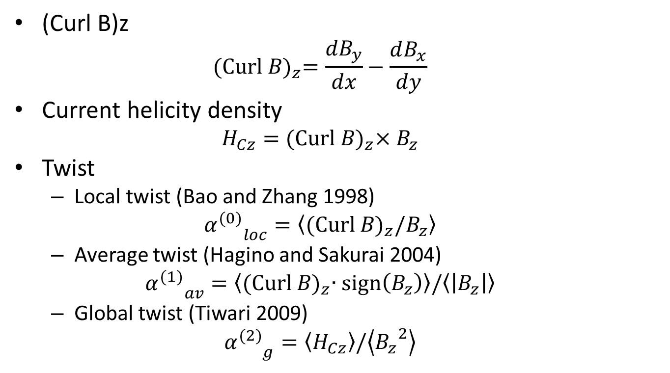
Calculation of Helical Parameters
(Curl B)z
$${\text{(}\text{Curl} B\text{)}}_{z}=\frac{{dB}_{y}}{dx}−\frac{dB_{x}}{dy}$$
Current helicity density
$$H_{Cz}={\text{(}\text{Curl} B\text{)}}_{z}×B_{z}$$
Twist
Local twist (Bao and Zhang 1998)
$${α_{}^{(0)}}_{loc}=\left\langle {\text{(}\text{Curl} B\text{)}}_{z}/B_{z}\right\rangle$$
Average twist (Hagino and Sakurai 2004)
$${α_{}^{(1)}}_{av}=\left\langle {\text{(}\text{Curl} B\text{)}}_{z}∙\text{sign}\left(B_{z}\right)\right\rangle /\left\langle \left|B_{z}\right|\right\rangle$$
Global twist (Tiwari 2009)
$${α_{}^{(2)}}_{g}=\left\langle H_{Cz}\right\rangle /\left\langle {B_{z}}^{2}\right\rangle$$
Rotation of the magnetic field
on x-y plane

Slide 4
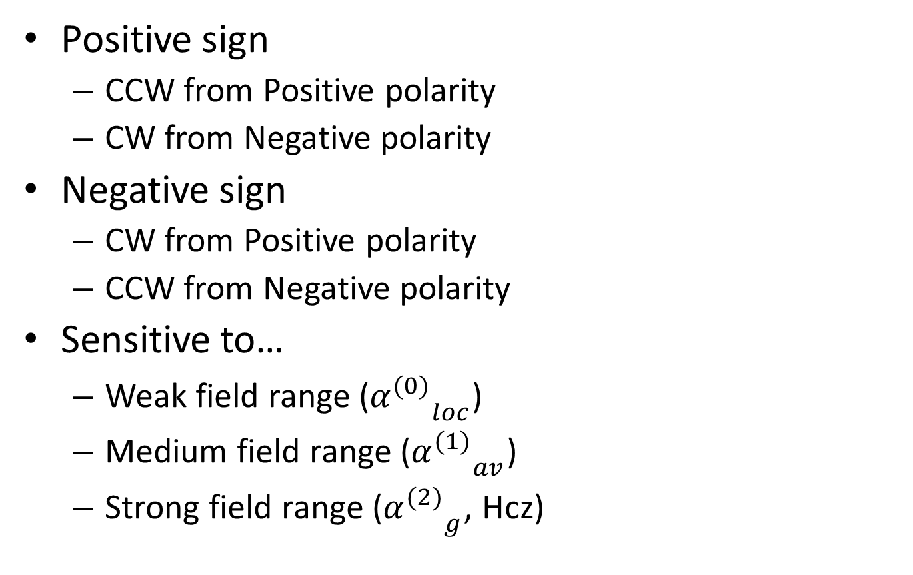
Sign of Helical Parameters
Positive sign
CCW from Positive polarity
CW from Negative polarity
Negative sign
CW from Positive polarity
CCW from Negative polarity
Sensitive to…
Weak field range (${α_{}^{(0)}}_{loc}$)
Medium field range (${α_{}^{(1)}}_{av}$)
Strong field range (${α_{}^{(2)}}_{g}$, Hcz)
+
-
+
-

Slide 5
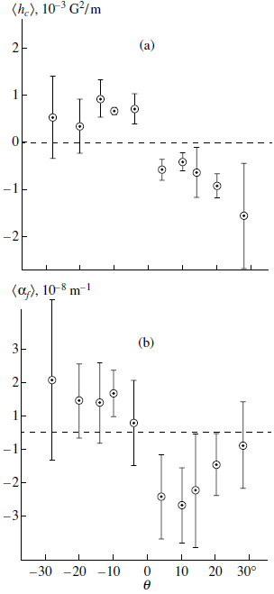
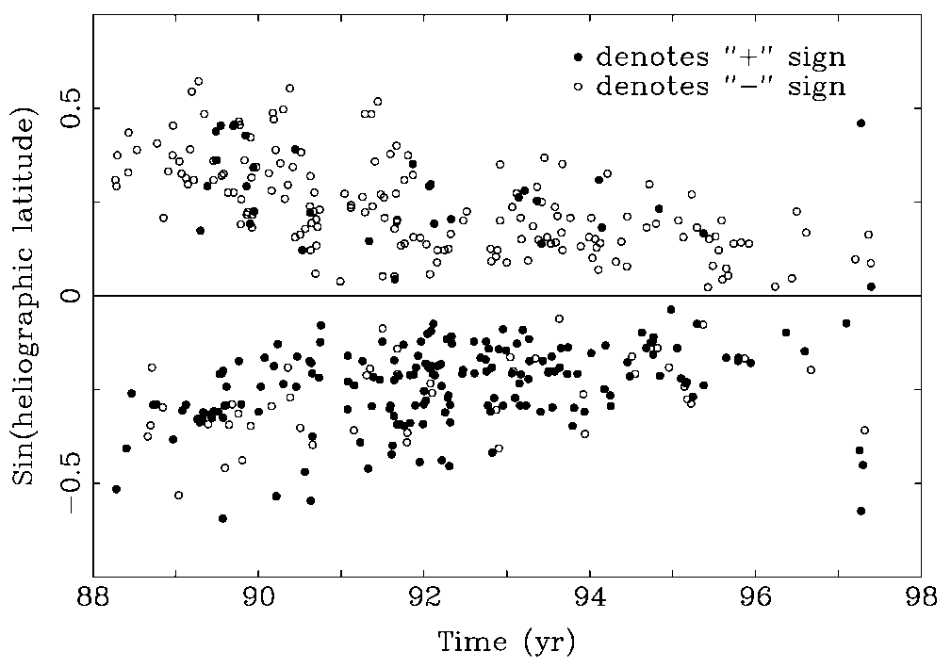
Preceding results (Ground)
Current helicity is mainly negative/positive in the northern/southern hemispheres of the Sun.
Bao & Zhang 1998, Zhang, Bao, Kuzanyan 2002
Using ground based fileter type magnetogram

Slide 6
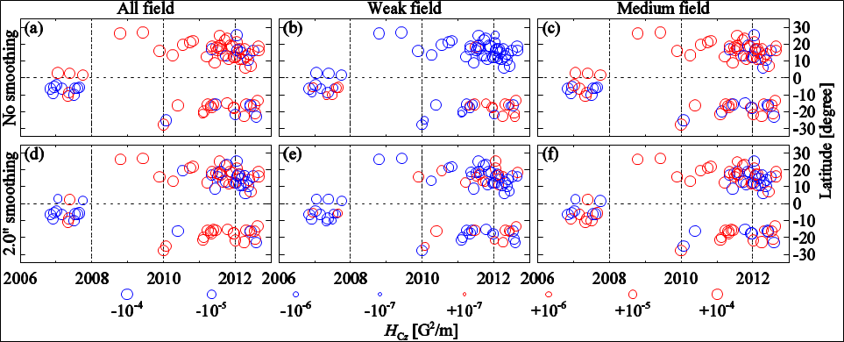
Preceding study (SOT/SP)
Otsuji et al. 2011
Opposite tendency of sign of helicity between the stronger and weak magnetic field.
Smoothing (mimicking atmospheric seeing effect) fluctuates the original trend of hemispheric rule.
To confirm these characteristics using more large dataset
obtained by Hinode/SOT

Slide 7
Data selection and reduction
Hinode SOT SP level2 data
Available from http://www.csac.hao.ucar.edu/
MERLIN code
Milne-Eddington gRid Linear Inversion Network
Data period: 2006-2015
Data selection criteria
Near disk center (<30deg)
FOV of map>10,000 [arcsec²]
area(|B|>1kG)>1,000[arcsec²]
Ratio of strong fields=area(|B|>1kG)/FOV~0.1-0.2
Selected: 2270 magnetograms of 296 Active Regions
180 degree disambiguation
Non potential approximation method (NPFC: Georgoulis 2005)

Slide 8
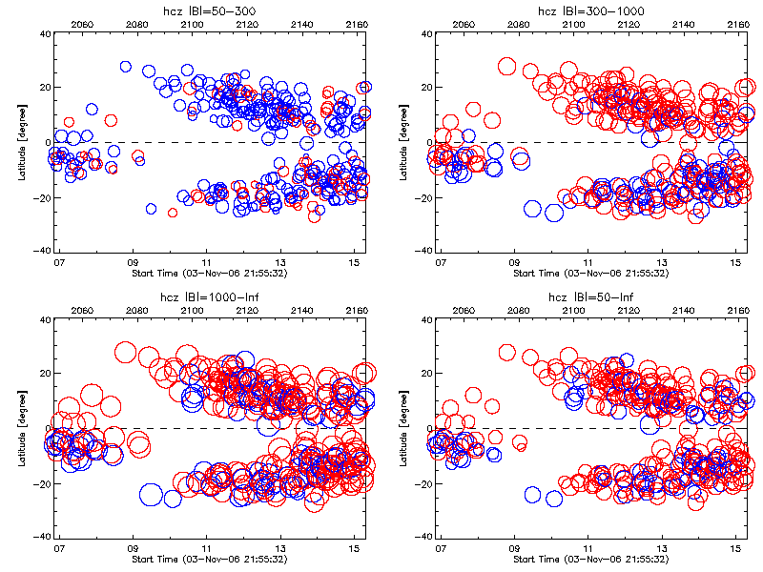
Hcz Butterfly diagram

Slide 9
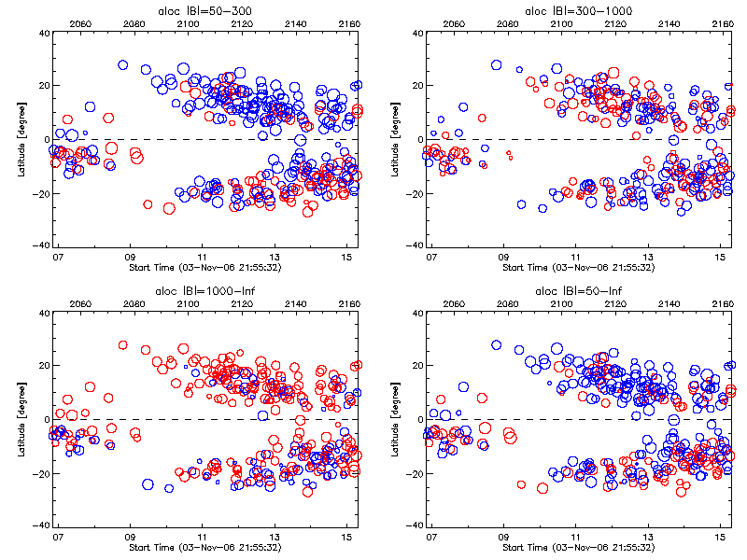

${α_{}^{(0)}}_{loc}$ Butterfly diagram

Slide 10
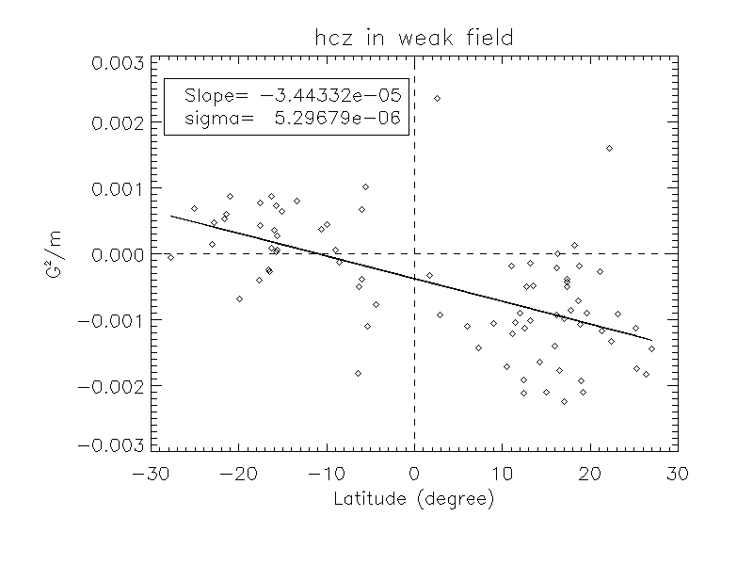
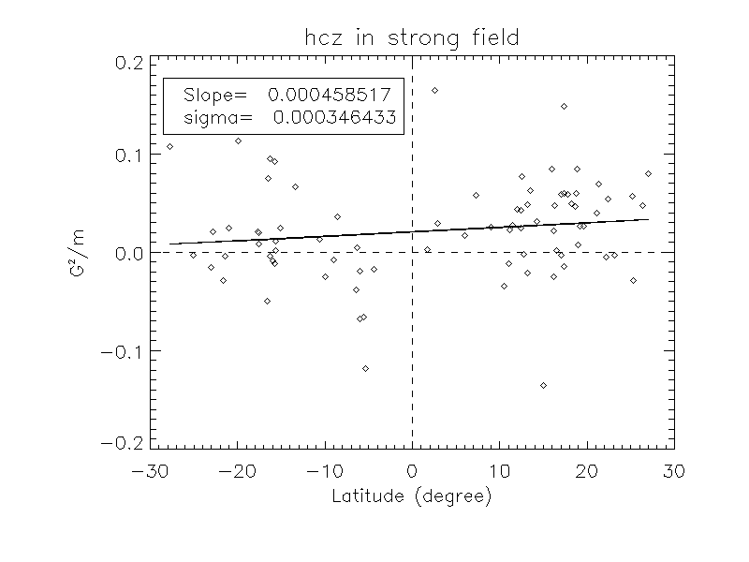
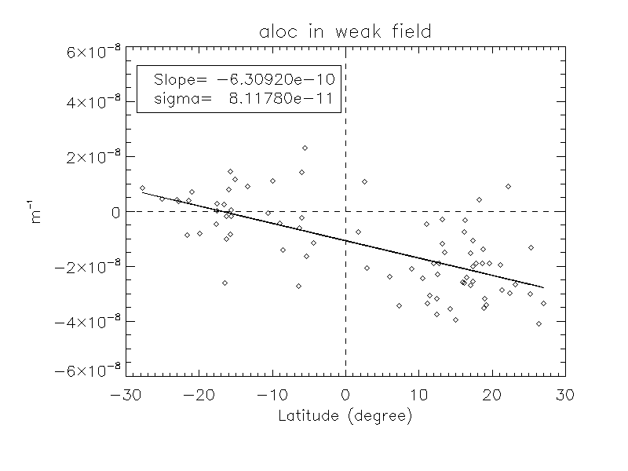
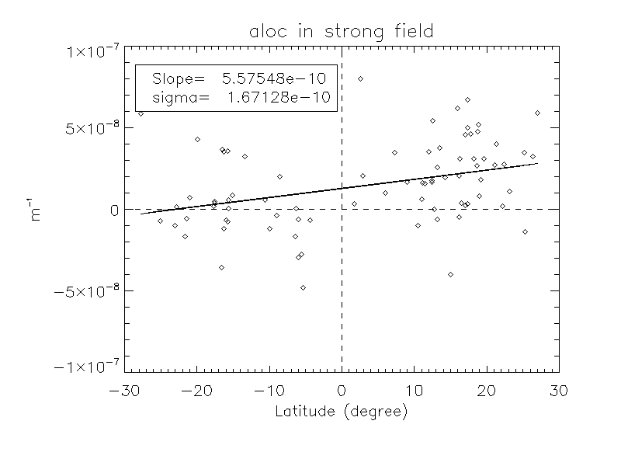
Latitude dependency of parameters
Every parameter show the hemispheric-rule in weak field range and
anti-hemispheric-rule in strong field range

Slide 11
Conclusions
We found different properties of helicity through the strong and weak values of magnetic field components:
current helicity for the weak magnetic fields (absolute field strength < 300 G) follows the so-called hemispheric sign rule [N-/S+], no smoothing
On the other hand, stronger field component does not obey the hemispheric rule
The characteristics of helical parameters in solar active regions were confirmed for longer period statistical observation data.

Slide 12
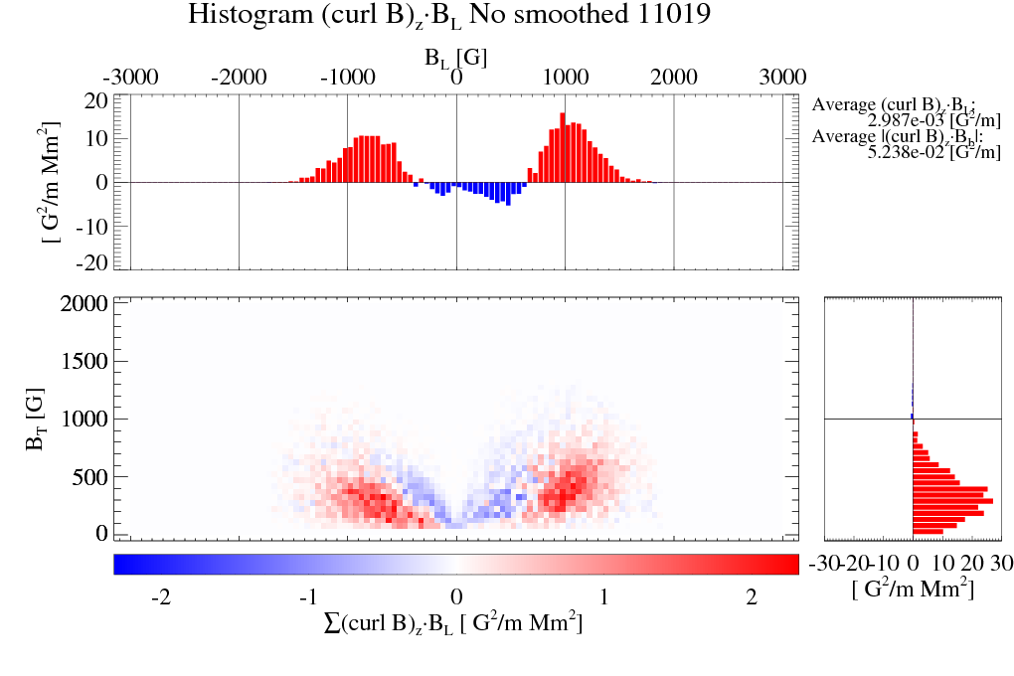
NOAA 11019 helicity (No smoothing) 2009-06-04 Latitude=27.000
B_{T}=|B_{L}|/2
Vertical field-> anti-hem. rule
horizontal field-> hem. rule

Slide 13
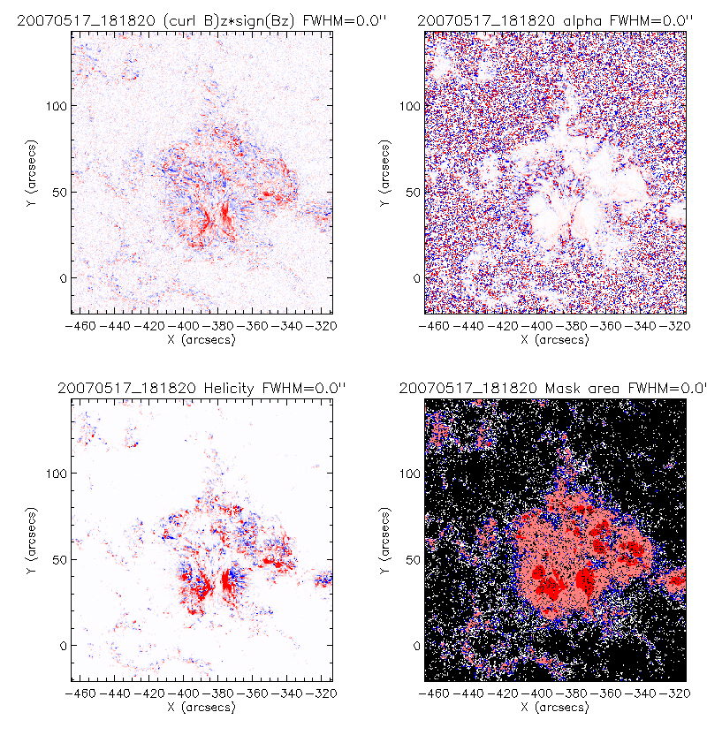
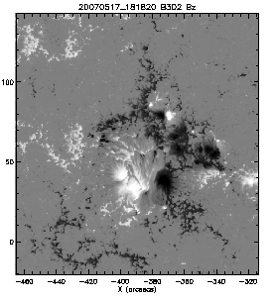
Example distribution of current helicity and local twist
B_{z}
Helicity
Local twist

